Slide 1
Introduction to Selenium

Slide 2
What is Selenium?
Software-testing framework for web applications
Selenium IDE - record/playback tool for authoring tests without the need to learn a test scripting language
Selenese - Domain-specific language to write tests in a number of popular programming languages (Java, Ruby, Python, etc)
We will use this!
Can simulate a user navigating through pages and then assert for specific data on the pages

Slide 3
Code Along

Slide 4
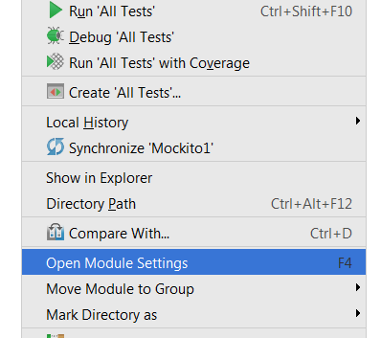
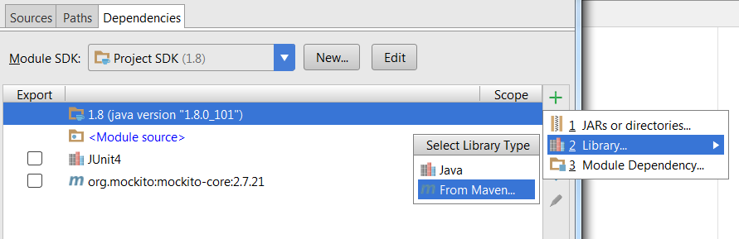
IntelliJ Setup

Slide 5
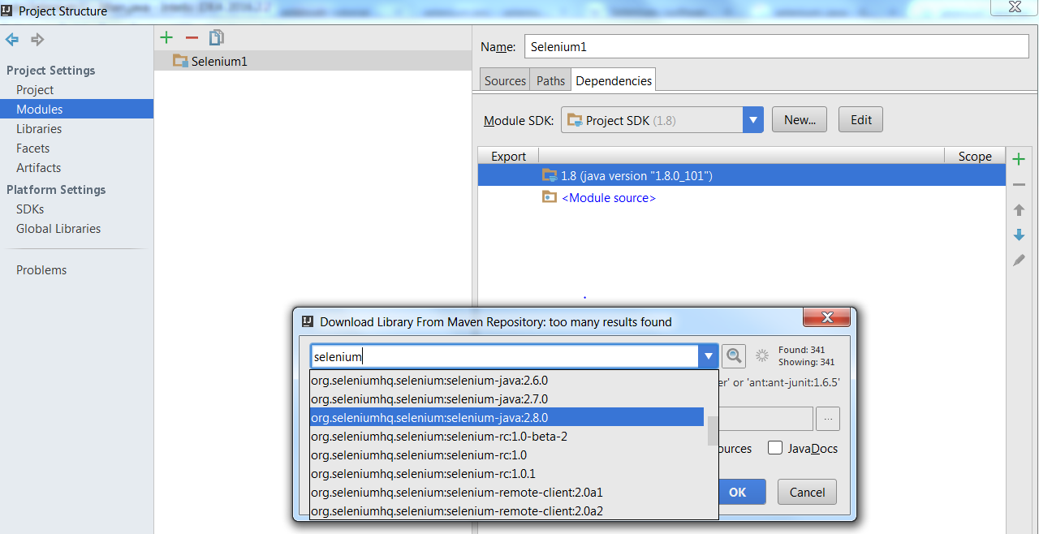
IntelliJ Setup

Slide 6
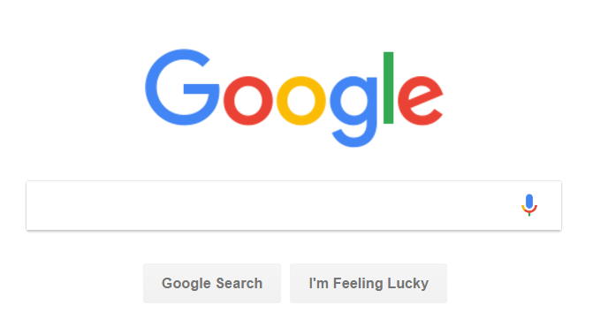
Our First Selenium Test
As mentioned, Selenium is used to test web applications
Let’s make a simple test
Search google for “GGC”
Make sure the page title contains GGC
The point is NOT having to do this MANUALLY!
We will write a Selenium test case to automate this

Slide 7
Our First Selenium Test
Use Chrome to run Selenium test
First download chromedriver:
https://sites.google.com/a/chromium.org/chromedriver/downloads
public class HelloSelenium {
private static WebDriver driver;
@BeforeClass public static void setUpChrome() { // Create a new WebDriver instance (Use Chrome) // download ChromeDriver from: // and put the path here... System.setProperty("webdriver.chrome.driver",
"C:\\Users\\you\\Downloads\\chromedriver.exe"); driver = new ChromeDriver(); }

Slide 8
Our First Selenium Test
@Test public void googleSearchExample() throws Exception { // Use webdriver to visit Google driver.get("http://www.google.com"); // Find the text input element by its name WebElement element = driver.findElement(By.name("q")); // Enter something to search for element.clear(); element.sendKeys("GGC"); // Now submit the form. WebDriver will find the form for us from the element element.submit();
How do you know this???

Slide 9
Chrome – F12 Developer Tools
Hit F12 or Menu → More Tools → Developer Tools
Use this to find names of HTML elements that we can refer in our code
We want to write code saying “Go to the search input box and type in the text GGC”. We first need to find the name of the search input box in HTML.

Slide 10
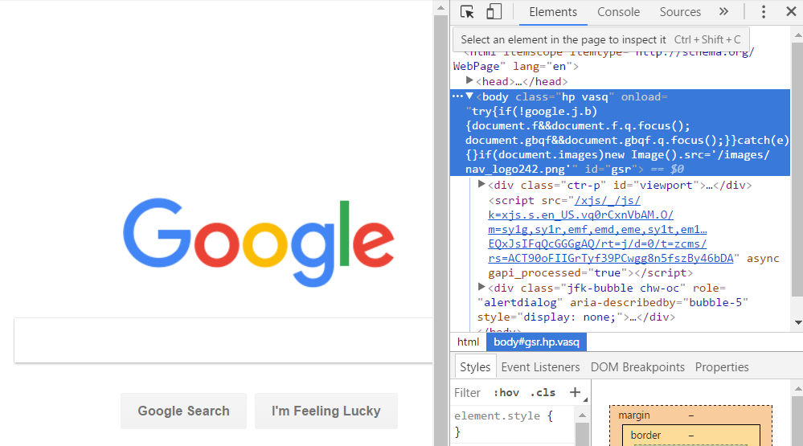
Chrome – F12 Developer Tools
First, click this button so you can select an element in HTML page, and it shows you the selected HTML source.

Slide 11
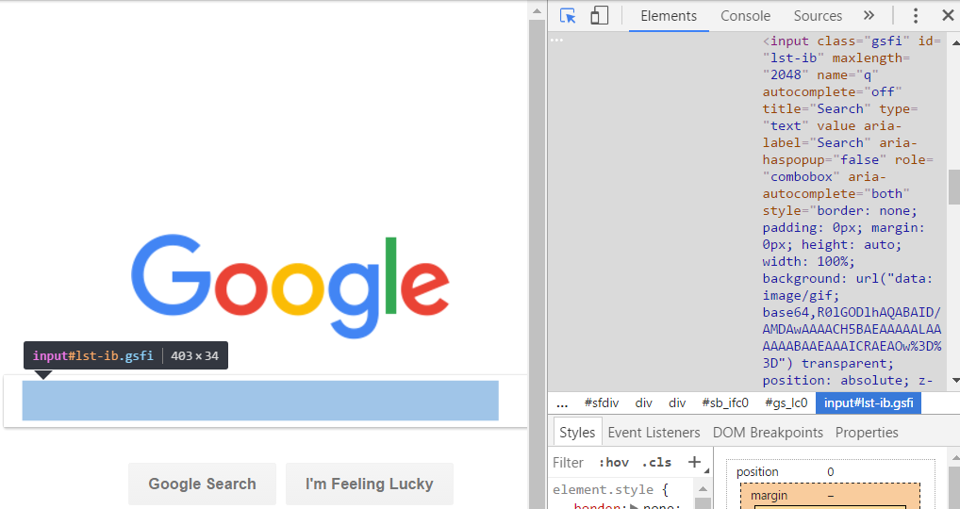
Chrome – F12 Developer Tools
Now click on the search input box, and you will see the HTML source on the right. Find the “name” attribute, which is “q”

Slide 12
Back to Our First Selenium Test
@Test public void googleSearchExample() throws Exception { // Use webdriver to visit Google driver.get("http://www.google.com"); // Find the text input element by its name WebElement element = driver.findElement(By.name("q")); // Enter something to search for element.clear(); element.sendKeys("GGC"); // Now submit the form. WebDriver will find the form for us from the element element.submit();
So we got this name “q” by inspecting the HTML element
Now we type in GGC to the search box
And submit the form

Slide 13
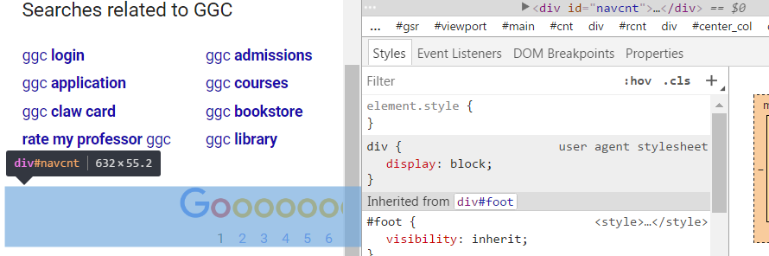
Back to Our First Selenium Test
//... Form is submitted...
//Set the implicit wait of the driver: driver.manage().timeouts().implicitlyWait(10, TimeUnit.SECONDS); WebElement nextPageElement = driver.findElement(By.id("navcnt")); System.out.println("Page title is: " + driver.getTitle()); }
assertTrue("Expected GGC in title", driver.getTitle().contains("GGC"));
This “navcnt” was found by inspecting the HTML element of the results page

Slide 14

In-Class Exercise
Write a new selenium test
Want to test the registration page at
https://ihgrewardsclubdining.rewardsnetwork.com/join.htm

Slide 15
In-Class Exercise
Write a test to:
Populate the form with data using selenium WebDriver
Same as the example shown today
Submit the form
Once you submit the form, it takes you to a new page to enter more data (like address)
Confirm it takes you to the next page by finding the “address1” input box.

